Slide 1
LEAD SCORING CASE STUDY
Submitted By
Shagufta Naz
Minal Devda
Prachi Singh

Slide 2
Contents
*Problem statement
* Problem approach
* EDA
* Correlations
* Model Evaluation
*Observations
* Conclusion

Slide 3
Problem Statement
An education company named X Education sells online courses to industry professionals. On any given day, many professionals who are interested in the courses land on their website and browse for courses.
The company markets its courses on several websites and search engines like Google. Once these people land on the website, they might browse the courses or fill up a form for the course or watch some videos. When these people fill up a form providing their email address or phone number, they are classified to be a lead. Moreover, the company also gets leads through past referrals. Once these leads are acquired, employees from the sales team start making calls, writing emails, etc. Through this process, some of the leads get converted while most do not. The typical lead conversion rate at X education is around 30%.
There are a lot of leads generated in the initial stage, but only a few of them come out as paying customers. In the middle stage, you need to nurture the potential leads well (i.e. educating the leads about the product, constantly communicating etc. ) in order to get a higher lead conversion.
X Education has appointed you to help them select the most promising leads, i.e. the leads that are most likely to convert into paying customers. The company requires you to build a model wherein you need to assign a lead score to each of the leads such that the customers with higher lead score have a higher conversion chance and the customers with lower lead score have a lower conversion chance. The CEO, in particular, has given a ballpark of the target lead conversion rate to be around 80%.

Slide 4
Goals of the Case Study
Build a logistic regression model to assign a lead score between 0 and 100 to each of the leads which can be used by the company to target potential leads. A higher score would mean that the lead is hot, i.e. is most likely to convert whereas a lower score would mean that the lead is cold and will mostly not get converted.

Slide 5
Approach
Importing Data
- Inspecting the Dataframe
- Data Preparation (Encoding Categorical Variables, Handling Null Values, outlier detection)
- EDA (univariate analysis, checking data imbalance)
- Dummy Variable Creation
- Test-Train Split
- Feature Scaling
- Looking at Correlations
- Model Building (Feature Selection Using RFE, Improvising the model further inspecting adjusted R-squared, VIF and p-vales)
- Build final model
- Model evaluation with different metrics Sensitivity, Specificity

Slide 6
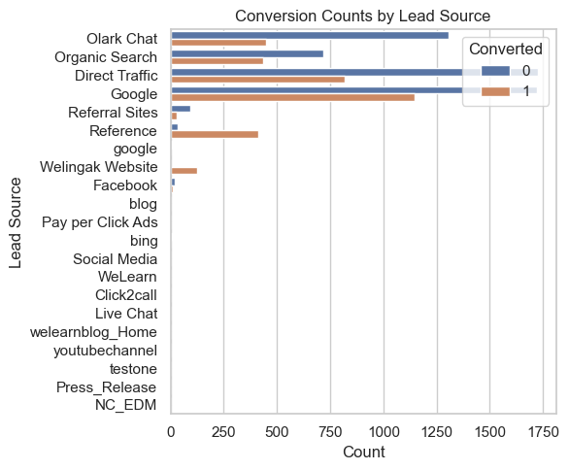
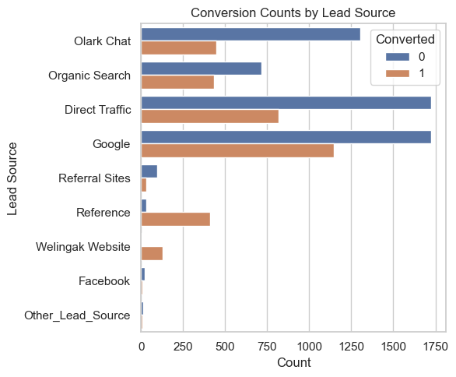
EDA –Data cleaning

Slide 7
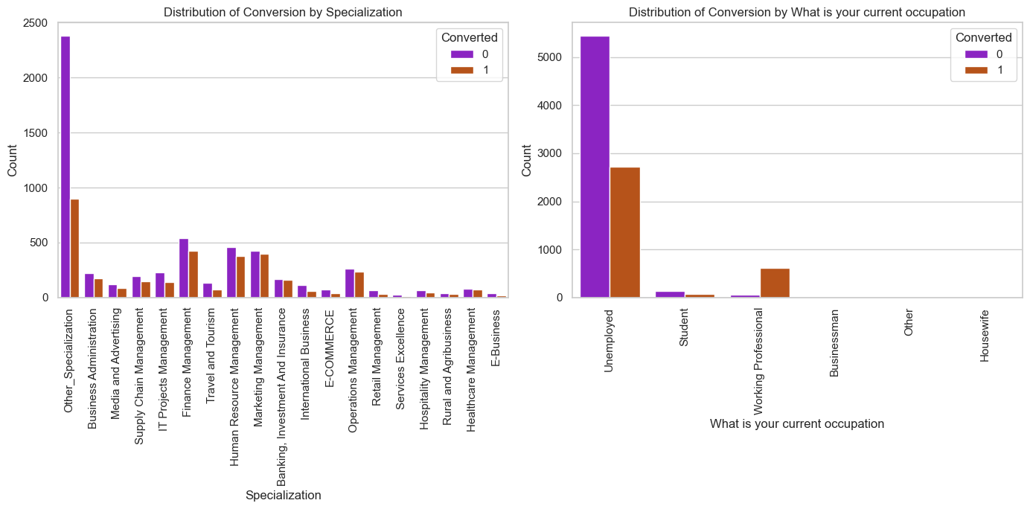
Specialization And the conversion

Slide 8
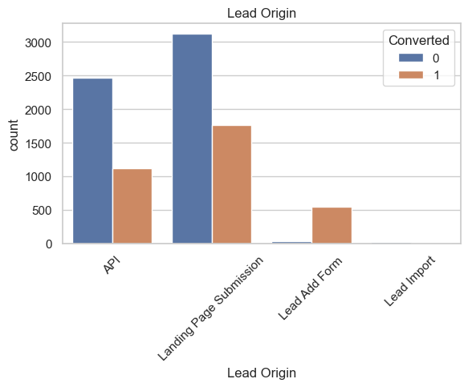
Lead Source & Lead origin In lead source the leads through google & direct traffic high probability to convert Whereas in Lead origin most number of leads are landing on submission

Slide 9
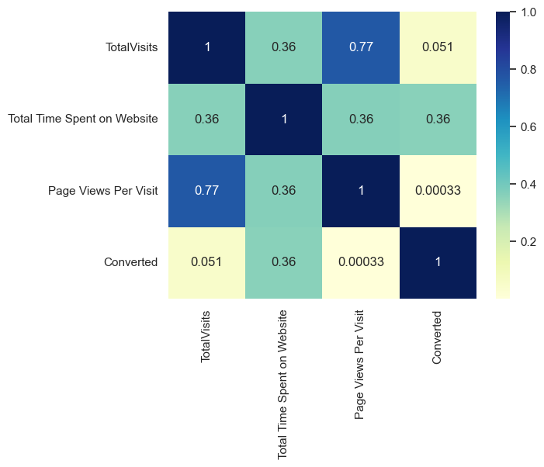
Correlation

Slide 10
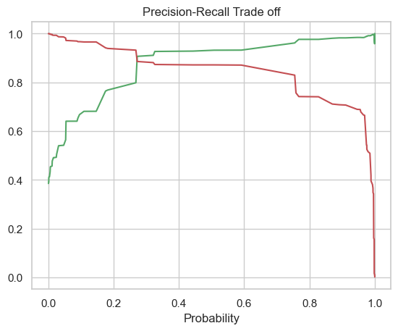
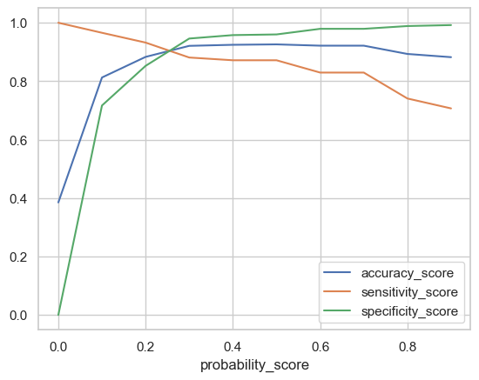
Model Evaluation The tradeoff between precision and recall is balancing correct positive identifications (recall) against minimizing false positives (precision).

Slide 11
Conclusion
*We see that the conversion rate is 30-35% (close to average) for API and Landing page submission. But very low for Lead Add form and Lead import. Therefore we can intervene that we need to focus more on the leads originated from API and Landing page submission.
* We see max number of leads are generated by google / direct traffic. Max conversion ratio is by reference and welingak website.
* Leads who spent more time on website, more likely to convert.  Most common last activity is email opened. highest rate = SMS Sent. Max are unemployed. Max conversion with working professional.

